Slide 1
Task 2: Requirement Gathering
Design and Implementation of a Mobile App for Collection of User Experience Data from Mobile Network Subscribers
CEF440 Internet Programming and Mobile Programming
Stakeholder identification
Techniques used
Data gathering
Data cleaning
User reluctance assessment
1

Slide 2
Why Requirement gathering is critical for our project
Understand who the app is for and what each stakeholder needs
Collect real network experience data from mobile subscribers
Identify feature expectations, data-sharing limits, and trust issues
Prepare clean input for requirement analysis and SRS
Survey responses
93 valid form submissions
Main output
Usable requirements for design
Next step
Analyze and formally document gatherings using use case diagrams
Presenter 1
2

Slide 3
Stakeholder identification
Primary stakeholders
Secondary stakeholders
Subscribers
Provide QoE feedback and usage context
Network analysts
Interpret patterns and problem areas
Network Engineer
Manages records, permissions and support
Lecturer / assessors
Evaluate project method and deliverables
Telecom operators
Use collected insight for optimisation
Regulators / researchers
Potential long-term users of aggregated insights
Presenter 2
3

Slide 4
Requirement gathering techniques used
Survey questionnaire
Main technique Used to reach many subscribers quickly
Group brainstorming
Helped refine questions, features and scope
Review of similar apps
Guided what data, alerts and reports to ask for
Primary method in this phase: Google Forms survey
Structured questions + exportable CSV for analysis
Presenter 2
4

Slide 5
SURVEY RESULTS — Demographics & Usage
93 responses collected | April 23–27, 2026
93
92.5%
87.1%
96.8%
Responses
Aged 18–25
Students
Daily Users
OPERATOR SHARE
OPERATING SYSTEM
NETWORK TYPE

Slide 6
SURVEY RESULTS — Network Problem Experience
94% of users experience network issues with non-trivial frequency
FREQUENCY OF ISSUES
TYPES OF PROBLEMS ENCOUNTERED (% of respondents)
Key Finding: Slow internet speed (81.7%) is the #1 issue → the app MUST prioritize bandwidth/throughput monitoring

Slide 7
SURVEY RESULTS Willingness & Desired Features
What will users accept?
USER WILLINGNESS
DESIRED FEATURES
Allow Data Collection
Yes 29%
Maybe 64.5%
No
Periodic Notifications
Yes 41.9%
Maybe 46.2%
No
Location Sharing
Yes 47.5%
Maybe 40%
No
93.5% want personal performance reports

Slide 8
REVERSE ENGINEERING — Key Findings
What existing apps taught us — and what they're missing
Observation | App | Requirement for Our System
Collects RSRP, SINR, RSSI | Both | Collect same RF metrics as core parameters
Map-based coverage visualization | OpenSignal | Include map-based network quality view by location
No offline data storage | Both | Store data locally first; upload when online
No coverage prediction | Both | Design for future ML-based prediction module
Complex UI for non-technical users | Net Cell Info | Simple interface — navigable within 3 minutes
Auto crowdsensing is opaque to users | OpenSignal | Show users when collection is active; allow opt-out
No WiFi-only upload mode | Both | Allow users to restrict uploads to WiFi only

Slide 9
Data gathering process
1
Design survey Questions on usage, network issues, concerns and features
2
Distribute form Shared with mobile network subscribers
3
Collect responses 93 responses captured through Google Forms
4
Export dataset Responses exported as CSV for cleaning and summary
Question areas: profile, usage, network experience, sharing, preferences
Presenter 3
5

Slide 10
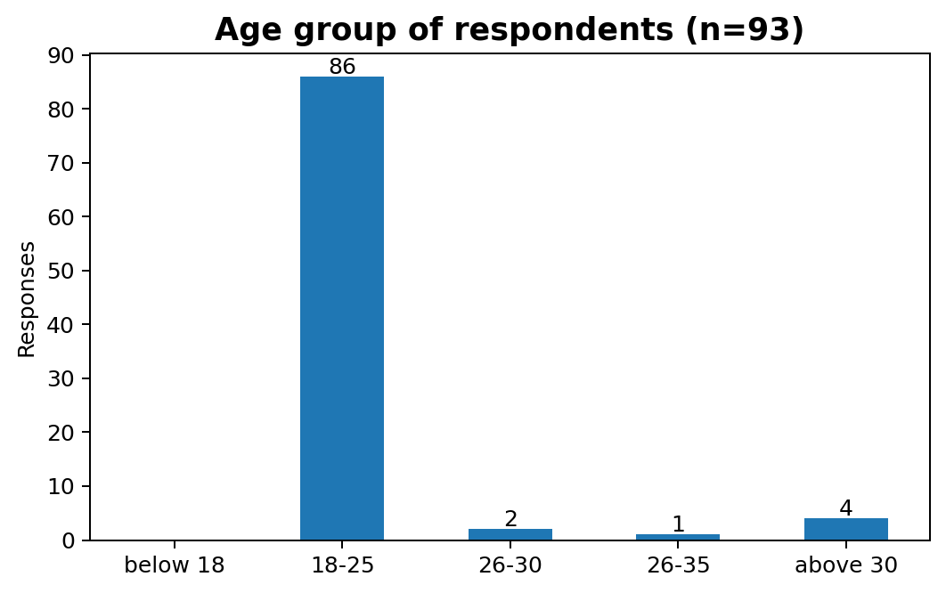
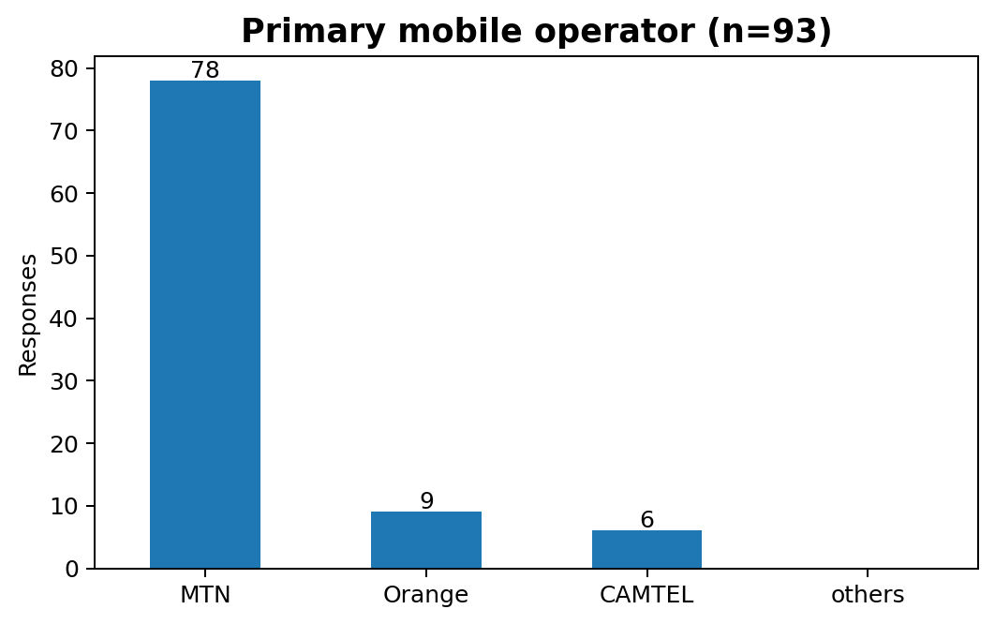
Survey Review and Analysis
Occupation
81 of 93 respondents were students
Operating system
51 Android, 42 iOS
Usage intensity
90 respondents use mobile internet frequently
Presenter 3
6

Slide 11
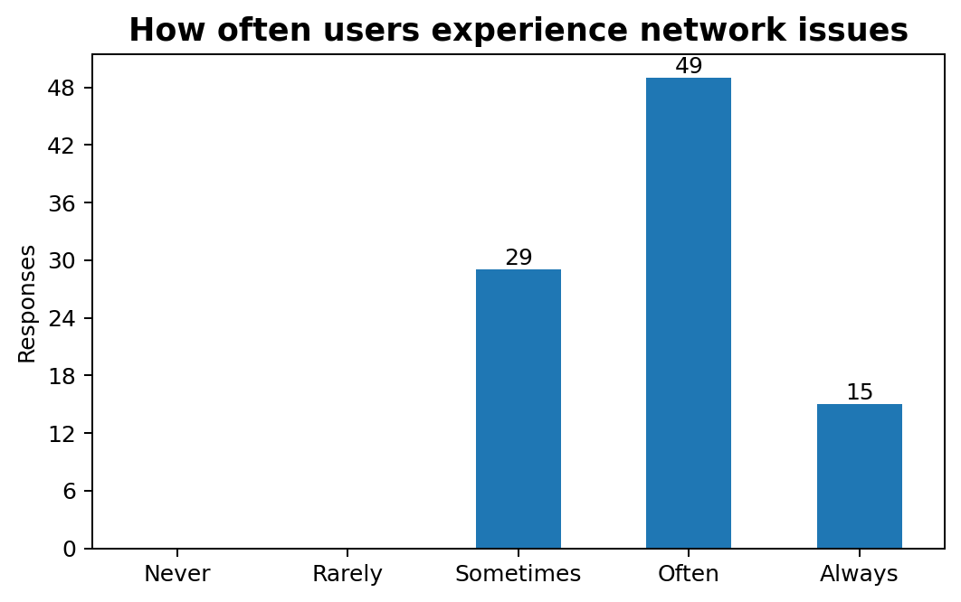
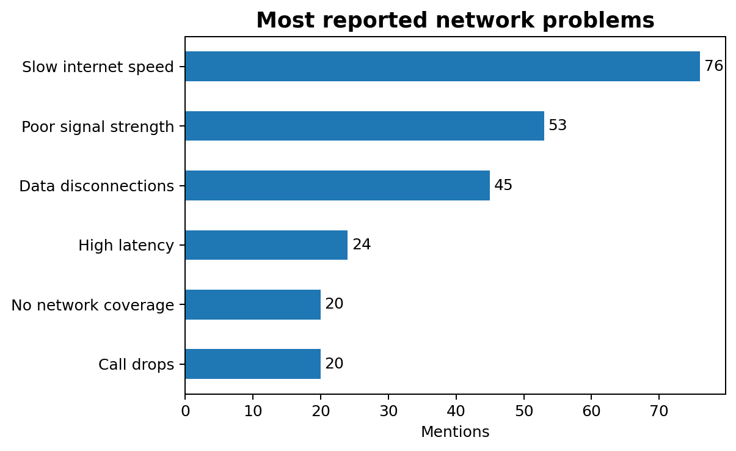
What users reported
Main takeaway
Network problems are common; slow internet speed and poor signal strength dominate the user experience.
Presenter 4
7

Slide 12
Data cleaning carried out
Inspect export
Checked columns, missing responses and inconsistent labels
Tidy structure
Renamed stray column, removed irrelevant spacing, reviewed blanks
Prepare analysis
Split multi-select answers into countable categories
Summarise output
Converted raw responses into charts and key findings
Examples from the dataset
Unnamed gender column, mixed response formats needed cleanup before interpretation.
Presenter 4
8

Slide 13




USER RELUCTANCE ASSESSMENT
Barriers are real — and addressable
68.8%
58.1%
36.6%
35.5%
Privacy Concerns
Data Consumption
Security Risks
Battery Drain
RELUCTANCE SEVERITY
MITIGATION STRATEGIES
High (Hard Refusers)
~10–13%
Explicit granular consent at onboarding
Plain-language privacy policy in-app
Anonymize data before transmission
Show app's own data usage counter
TLS 1.2+ encryption + AES-256 local storage
Adaptive polling to minimize battery drain
WiFi-only sync option
User-controlled permission toggles
Moderate (Open to persuasion)
~40–48%
Low / Willing
~39–45%

Slide 14
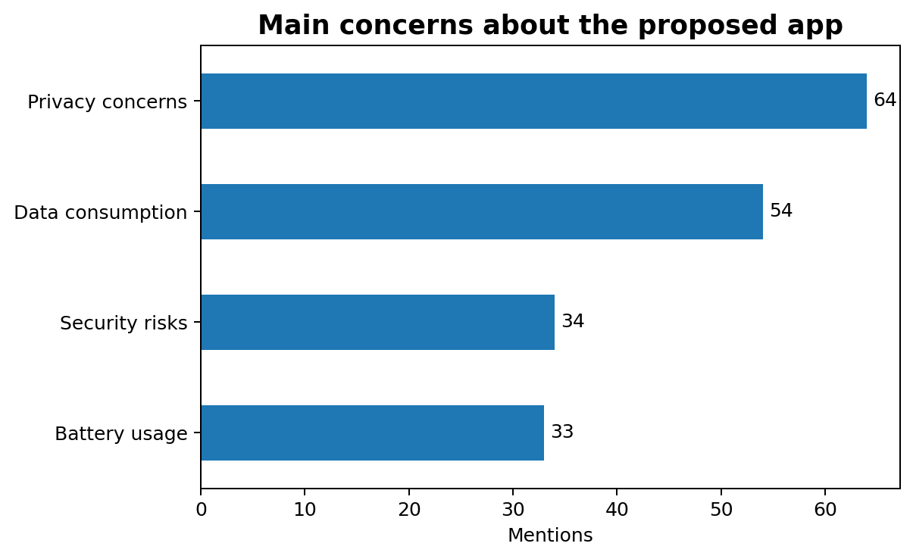
User reluctance assessment
Automatic data collection
27 yes • 60 maybe • 6 no
Periodic notifications
39 yes • 43 maybe • 11 no
Location sharing*
19 yes • 16 maybe • 18 no
*53 respondents answered this question.
Presenter 5
9

Slide 15
DERIVED REQUIREMENTS
Functional & Non-Functional
FUNCTIONAL REQUIREMENTS
NON-FUNCTIONAL REQUIREMENTS
Background service: collect signal, network type, latency, packet loss, bandwidth
Real-time dashboard showing live network performance metrics
Push notifications when quality drops below thresholds
Timestamped performance history logs
Subjective satisfaction ratings triggered by detected issues
GPS/location data linked to readings (with consent)
App data consumption display
Privacy
TLS 1.2+ for all transmissions; device IDs hashed before storage
Privacy
Explicit informed consent before any collection begins
Performance
Battery impact ≤ 3% additional drain per hour
Performance
Background data ≤ 5 MB/day under standard settings
Usability
Main interface navigable by first-time user within 3 minutes
Reliability
Zero data loss on connection interruption via local queue
Security
AES-256 local storage; no raw personal IDs on device

Slide 16



CONCLUSION
What we know — and where we go next
94% of users experience frequent network issues — strong market validation
93.5% want personal network performance reports — a powerful incentive for adoption
Top problems: Slow internet (81.7%), poor signal (57%), disconnections (48.4%)
Privacy & data consumption are the primary adoption barriers — addressed through privacy-by-design
Users prefer event-driven notifications (54.8%) over fixed schedules
Cross-platform (Android 54.8% / iOS 45.2%) development is mandatory

Slide 17
Conclusion and final judgment
Transparent permissions
Users want clear control over data collection
Low-friction feedback
Prompts should be limited and preferably issue-based
Useful user value
Reports, alerts and live performance views matter
What does this means for our subsequent task?
Requirements can now be analysed, classified, prioritised and documented
10

